Slide 1
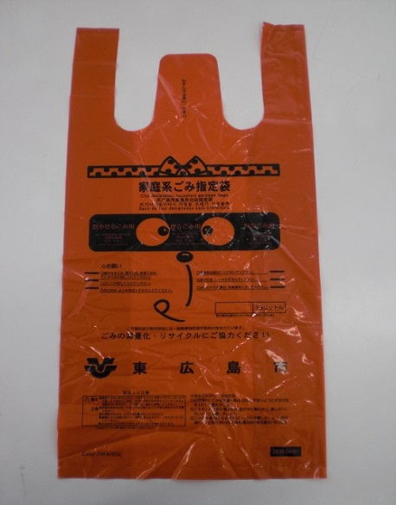
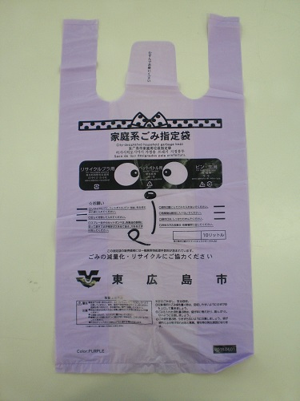
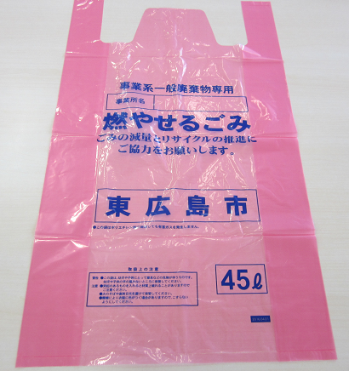
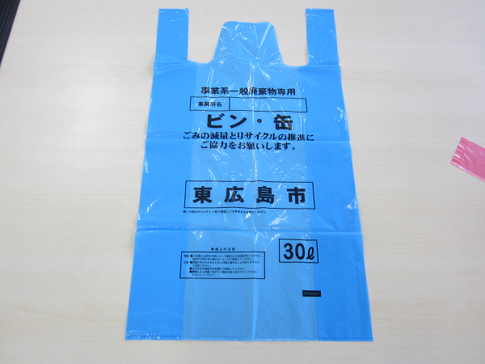
Notice
This garbage station is only for household garbage!
Only bags for household garbage（orange or purple） can be disposed of here!
Burnable Garbage
Recyclable Plastics
Dangerous Garbage
Bottles & Cans
PET Bottles
Hazardous Garbage
Other Plastics
Bags for business garbage（red and blue） cannot be collected from this garbage station!

